Slide 1
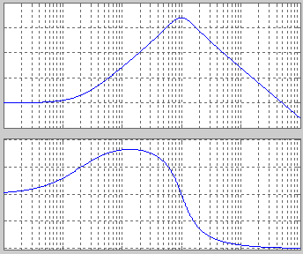
Bode Plot
It consists of two plots
Plot of log(M) versus log ω
Plot of φ versus log ω
M: gain, φ: phase, ω: frequency
One decade of ω
4
10⁴
3
10³
log (M)
10²
2
M
1
10
0
1
-1
10⁻¹
90°
One decade of ω
45°
Degree is widely used as unit for phase
Frequency is changed by factor of 10 over one decade
0°
-45°
-90°
10¹
10²
10⁴
10⁻¹
10⁰
10³
EE3331C/EE3331E Feedback Control Systems
A/Prof. Abdullah Al Mamun, ECE, NUS

Slide 2
Bode Plot
Why Log Magnitude?
In frequency domain, controller design requires to find how the frequency response is altered if a controller is put in series with the plant
Overall frequency response:
Overall gain and phase of the inter-connected system:
Overall gain is product of individual gains
Overall phase is sum of individual phases
EE3331C/EE3331E Feedback Control Systems
A/Prof. Abdullah Al Mamun, ECE, NUS

Slide 3
Bode Plot
Hand-sketching Sum of functions versus Product of functions
Given the plots of two functions y₁(x) and y₂(x),
Hand-sketching the plot of y₁(x)+y₂(x) is easier than sketching the plot of y₁(x)y₂(x)
Hand-sketch the plots for y₁+y₂ and y₁y₂.
EE3331C/EE3331E Feedback Control Systems
A/Prof. Abdullah Al Mamun, ECE, NUS

Slide 4
Bode Plot
Why Log Magnitude?
Given the plots of ∠G_{p}(logω) and ∠G_{c}(logω),
It is straightforward to hand-sketch the plot of ∠G (logω)
But it is not so simple to hand-sketch the plot of |G (logω)| from the plots of |G_{p} (logω)| and |G_{c} (logω)|
If Log magnitude is considered then it becomes sum
So instead of plotting gain (or magnitude), we plot log of gain
Sometime, magnitude axis is labeled in dB (decibel) scale
EE3331C/EE3331E Feedback Control Systems
A/Prof. Abdullah Al Mamun, ECE, NUS

Slide 5
Bode Plot
Sketching the Bode Plot
Point by Point sketching
Data can be obtained either from experiment of by evaluating G(jω) for ω = ω₀, ω₁, ω₂, ….., if G(s) is given
Direct hand-sketching if G(s) is given
We are going to learn this technique next
Any transfer function can be expressed as product of three types of factors
[pole or zero at the origin]
[real-axis pole or zero giving linear factor]
[complex pole or zero resulting in quadratic factor]
EE3331C/EE3331E Feedback Control Systems
A/Prof. Abdullah Al Mamun, ECE, NUS

Slide 6
Bode Plot
First, we learn to sketch the plots for each of the basic factors
Bode plot of a composite G(s) can be sketched by adding the Bode plots of these individual factors
Bode plot of this transfer function can be sketched by adding Bode plots of the following terms
[one pole at the origin]
[real-axis zero]
[real-axis pole]
EE3331C/EE3331E Feedback Control Systems
A/Prof. Abdullah Al Mamun, ECE, NUS

Slide 7
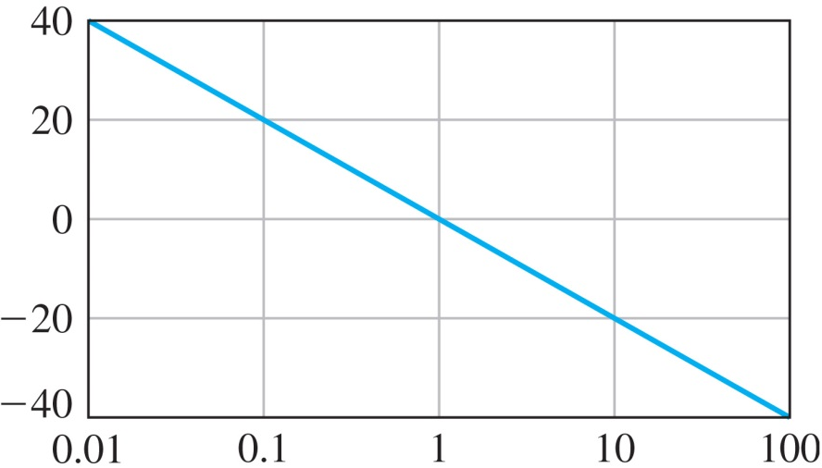
Bode Plot
Pole/zero at the origin
N > 0: Integrator
N < 0: Differentiator
N = 0: Pure Gain
Magnitude/Gain plot:
With logω as the independent variable, the equation above represents a straight line with slope of –N
In Bode plot terminology, it is called –N/decade slope
If dB scale is used,
logM
2
M_{dB}
1
The slope is –20N dB/decade
0
The intersection of the gain plot and the horizontal axis happens at ω=ω₀ where
-1
-2
EE3331C/EE3331E Feedback Control Systems
A/Prof. Abdullah Al Mamun, ECE, NUS

Slide 8
Bode Plot
Slope -20N dB/decade
Intersects the horizontal axis at ω₀ where
dB
ω
EE3331C/EE3331E Feedback Control Systems
A/Prof. Abdullah Al Mamun, ECE, NUS

Slide 9
Bode Plot
Phase plot:
Phase is constant regardless the value of ω
Phase plot is a horizontal line with vertical axis value equal to (-N×90°)
EE3331C/EE3331E Feedback Control Systems
A/Prof. Abdullah Al Mamun, ECE, NUS

Slide 10
Bode Plot
Real-axis pole/zero (magnitude plot)
Real-axis Pole:
Gain of the transfer function as function of ω
Unlike the case of integrator or differentiator, this is not a straight line’s equation
However, the plot of log(M) or M_{dB} versus logω can be approximated by straight lines for ω<<a and for ω>>a
Asymptotic Bode plot
EE3331C/EE3331E Feedback Control Systems
A/Prof. Abdullah Al Mamun, ECE, NUS

Slide 11
Bode Plot
The magnitude plot of G(jω) for a=10
dB
This segment is a straight line with slope 0
Actual magnitude plot
This segment is a straight line with negative slope
ω
EE3331C/EE3331E Feedback Control Systems
A/Prof. Abdullah Al Mamun, ECE, NUS

Slide 12
Bode Plot
Now, we find the equations of straight lines that approximate the actual plot
Low frequency,
The approximation of magnitude plot is a horizontal straight line for ω << a
The value is same as the gain for ω=0 or DC-gain
EE3331C/EE3331E Feedback Control Systems
A/Prof. Abdullah Al Mamun, ECE, NUS

Slide 13
Bode Plot
High frequency,
Magnitude plot approximation is a straight line with slope of -20 dB/decade
We can find the point of intersection of the two straight lines
Two lines intersect at a point ω=ω_{c} where,
This frequency is known as the corner frequency
EE3331C/EE3331E Feedback Control Systems
A/Prof. Abdullah Al Mamun, ECE, NUS

Slide 14
Bode Plot
Real-axis Zero:
As we did for the real-axis pole, we are going to approximate the plot of log(M) or M_{dB} versus logω using two straight lines: one for ω<<b and the other for ω>>b
Low frequency range,
Magnitude plot approximation is a horizontal straight line with vertical-axis value equal to the DC-gain,
EE3331C/EE3331E Feedback Control Systems
A/Prof. Abdullah Al Mamun, ECE, NUS

Slide 15
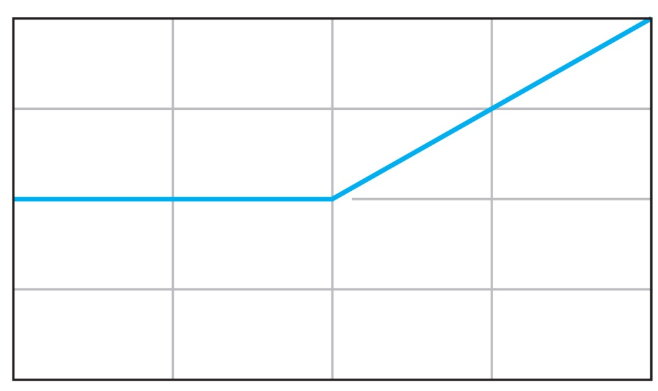
Bode Plot
High frequency range,
Magnitude plot approximation is a straight line with slope of +20 dB/decade
20 dB/div
logω
Two lines intersect at a point ω=ω_{c} where,
This frequency is known as the corner frequency
EE3331C/EE3331E Feedback Control Systems
A/Prof. Abdullah Al Mamun, ECE, NUS

Slide 16
Bode Plot
Sketching Bode (magnitude) Plot of Composite Transfer Function
Now we know how to sketch Bode (magnitude) plot of integrator, differentiator, real-axis pole and real-axis zero.
How do we combine them to sketch Bode plot of a composite G(s)
Bode (magnitude) plot of integrator/ differentiator/ real pole/ real zero: summary
Integrator/Differentiator | Real pole | Real zero
 | ω_{c} = a | ω_{c} = b
Line with -20N dB/decade slope for all ω | Line with slope 0 for ω<ω_{c}
 | Line with -20 dB/decade slope for ω>ω_{c} | Line with +20 dB/decade slope for ω>ω_{c}
Line intersects 0 dB line at ω₀ where (ω₀)^{N} = K₀ | Two lines intersects at ω=ω_{c}
Infinite dc-gain; can’t be shown on the plot | DC-gain is finite; vertical-axis value for the low frequency is equal to the dc-gain
EE3331C/EE3331E Feedback Control Systems
A/Prof. Abdullah Al Mamun, ECE, NUS

Slide 17
Bode Plot
Example 2-1: Sketch Bode (magnitude) plot of
There is no integrator, the dc-gain is finite.
The vertical-axis value of Bode (magnitude) for frequency much smaller than the smallest corner frequency is the dc-gain
Starting at this value for low frequency, the magnitude plot is horizontal line up to the smallest of the corner frequency, i.e., ω=1 where the slope is changed to -20 dB/decade
As we move towards higher frequency, at every corner frequency the slope is changed by +20 dB/decade for a zero and -20 dB/decade for a pole
EE3331C/EE3331E Feedback Control Systems
A/Prof. Abdullah Al Mamun, ECE, NUS

Slide 18
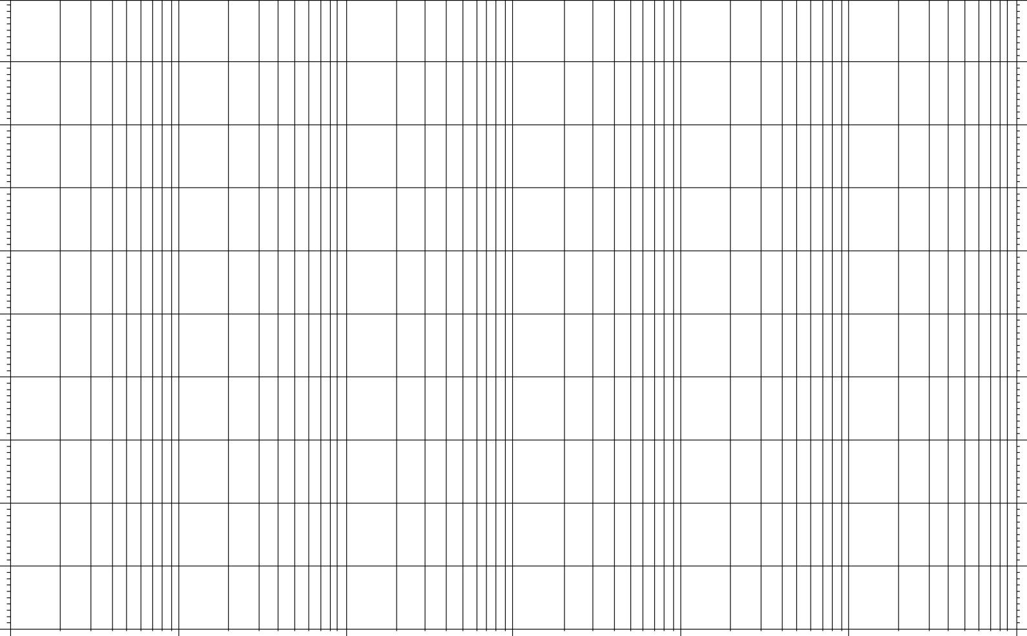
Bode Plot
10
0
-10
dB
-20
-30
10⁻³
10⁻²
10⁻¹
10⁰
10¹
10²
10³
EE3331C/EE3331E Feedback Control Systems
A/Prof. Abdullah Al Mamun, ECE, NUS

Slide 19
Bode Plot
Example 2-2: Sketch Bode (magnitude) plot of the transfer function
The dc-gain is infinite. How to choose the leftmost point of the magnitude plot?
Option 1: Choose a frequency much smaller than the smallest of the corner frequencies of real-axis poles and real-axis zeros
Determine the gain at that frequency. For the given G(s), let’s choose ω=1
Starting at this value, draw a line with -20 dB/decade slope
As we move towards higher frequency, at every corner frequency the slope is changed by +20 dB/decade for a zero and -20 dB/decade for a pole
EE3331C/EE3331E Feedback Control Systems
A/Prof. Abdullah Al Mamun, ECE, NUS

Slide 20
Bode Plot
10
0
-10
dB
-20
-30
10⁻³
10⁻²
10⁻¹
10⁰
10¹
10²
10³
EE3331C/EE3331E Feedback Control Systems
A/Prof. Abdullah Al Mamun, ECE, NUS

